Slide 1
PC Maintenance: Preparing for A+ Certification
Chapter 23: Using a Windows Network

Slide 2
Chapter 23 Objectives
Log on and off a network
Configure a PC for domain or workgroup
Manage the list of allowed users
Access other PCs on a network
Set up network shortcuts
Map a network drive
Share local folders and printers
Troubleshoot

Slide 3
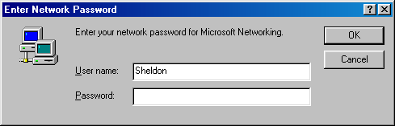
Windows 9x: Log On
No real security
You can click Cancel to bypass this box

Slide 4
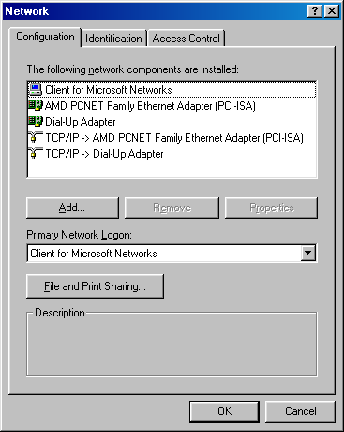
Windows 9x: Set Primary Login
Set primary login in Network properties

Slide 5
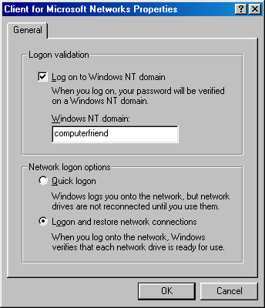
Windows 9x: Connect to a Domain
To connect to a domain, set it up in Client for Microsoft Networks Properties

Slide 6
Windows 9x: Log Off
Choose Logoff from the Start menu
Enter Network Password dialog box reappears

Slide 7
Windows 2000: Log On
If Logon prompt appears, cannot be bypassed. User must enter a valid user name and password
This gives Windows 2000 better local security than Windows 9x
Manage the allowed users from the Users and Passwords applet in the Control Panel

Slide 8
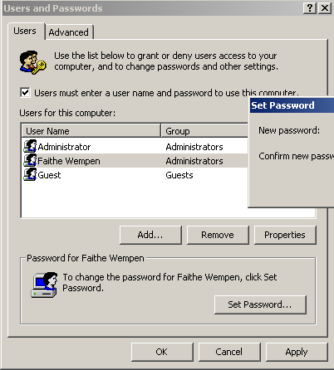
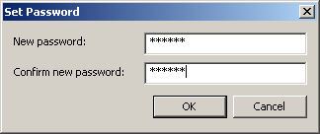
Windows 2000: Set Up Users
Create permissions for users to logon

Slide 9
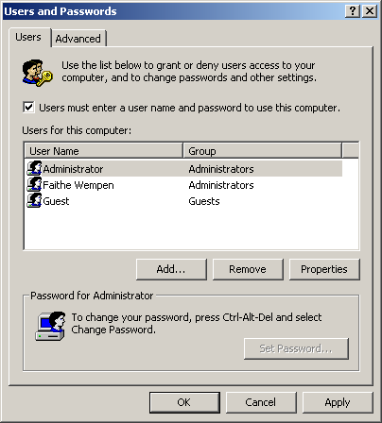
Windows 2000: Specify Whether Login is Required
You can choose whether logon is required from Users and Passwords box, from Control Panel

Slide 10
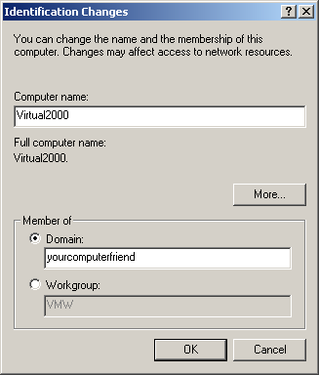
Windows 2000: Specify Domain
Open System Properties
Click Network Identification tab
Click Properties
Click Domain
Enter domain name

Slide 11
Windows 2000: Log Off
There is no Logoff command on the Start menu
Press Ctrl+Alt+Delete and then click the Logoff button

Slide 12
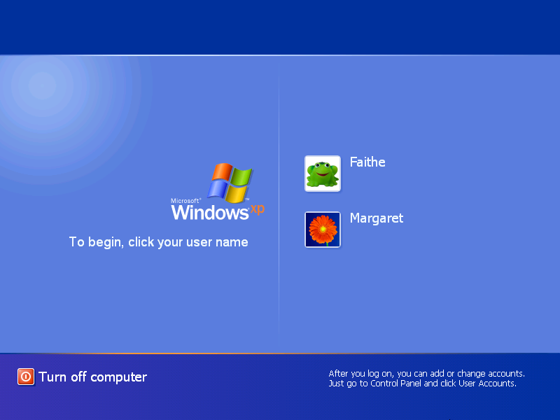
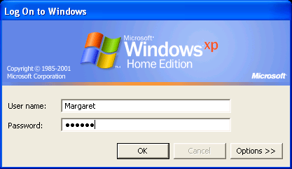
Windows XP: Log On
Welcome screen (default)
Log On to Windows

Slide 13
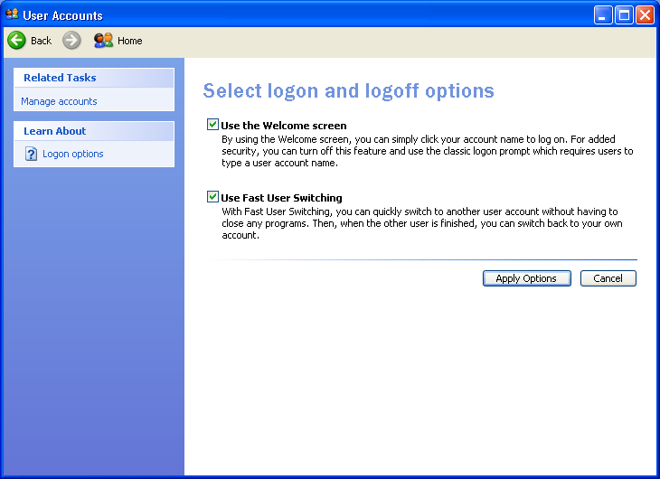
Windows XP: Choose Login Type
Go into User Accounts in Control Panel
Click Change the Way Users Log On or Off
Clear the Use the Welcome Screen checkbox

Slide 14
Windows XP: Log Off
Use any of these methods:
  Choose Log Off from Start menu
  Display Task Manager and then choose Shut Down, Log Off {username}
  Press Ctrl+Alt+Delete
    If Welcome screen in use, opens Task Manager
    If Welcome screen not in use, opens Windows Security box; click Log Off from there

Slide 15
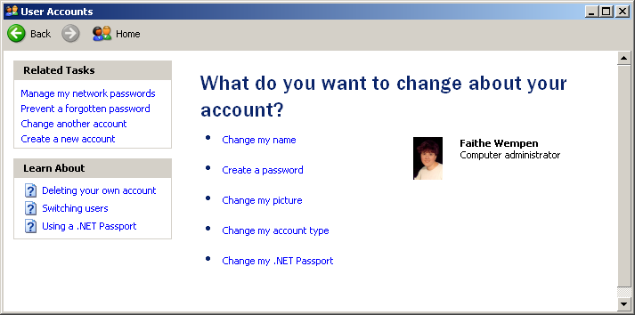
Windows XP: Manage User List
Create and change users from User Accounts in Control Panel

Slide 16
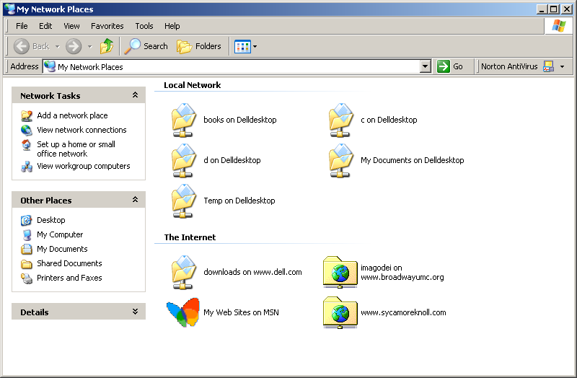
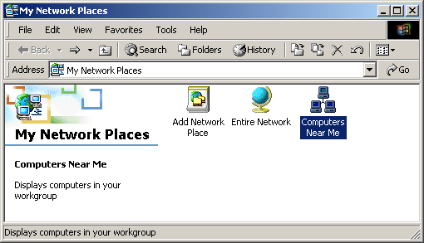
Browsing the Network
My Network Places: Windows XP, 2000, Me
Network Neighborhood: Windows 95, 98

Slide 17
Creating Network Shortcuts
Drag icons onto desktop from any network window
In Windows Me, 2000, or XP, use Add Network Place Wizard

Slide 18
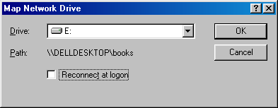
Mapping a Network Drive
Creates a drive letter shortcut to a network location
Can be set to automatically reestablish itself at startup
From Network Neighborhood:
  File, Map Network Drive
From My Network Places:
  Tools, Map Network Drive

Slide 19
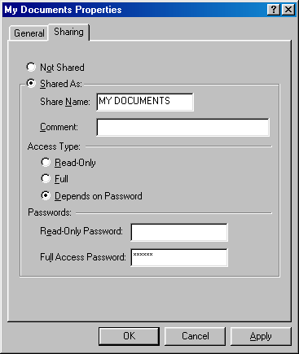
Sharing a Folder in Windows 9x
Right-click the folder and choose Sharing
Choose an access type
Assign passwords for access types (optional)

Slide 20
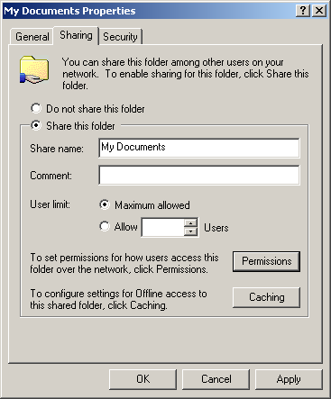
Sharing a Folder in Windows 2000
Right-click the folder and choose Sharing
Set user limit if desired

Slide 21
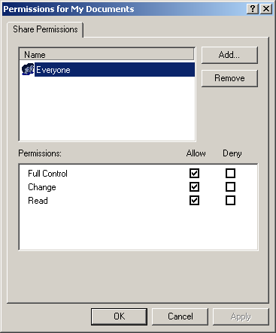
Sharing a Folder in Windows 2000
(Optional)
Click Permissions button to set permissions

Slide 22
Sharing a Folder in Windows XP
Right-click the folder and choose Sharing and Security
Allow users to change files or not
For more complex permission choices, turn off Simple File Sharing (in Folder Options)

Slide 23
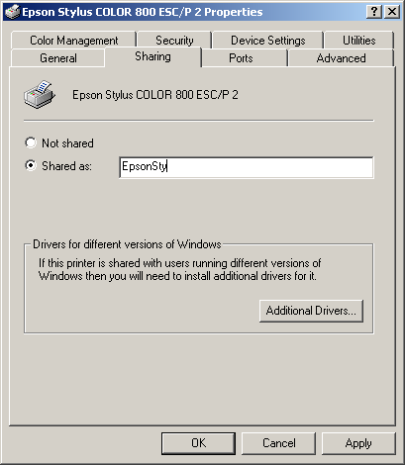
Sharing a Printer
Right-click printer and choose Sharing
Similar to sharing a folder

Slide 24
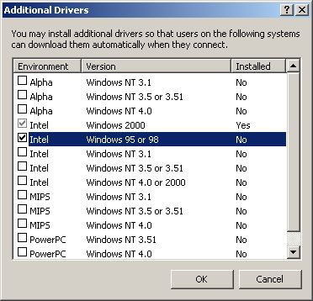
Loading Additional Printer Drivers
Helpful if other network users have different OS versions
Click Additional Drivers on Sharing tab of printer’s Properties box

Slide 25
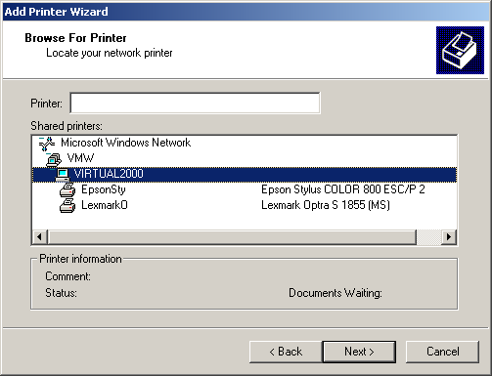
Using a Network Printer
Add the printer with Add Printer Wizard
Specify that it is
a network printer
Browse for it on the network

Slide 26
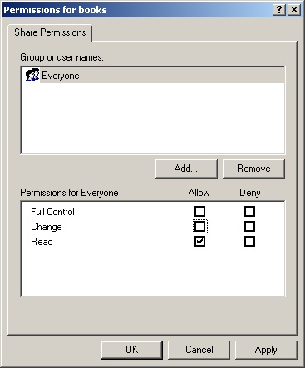
Working with Network Permissions
Applicable to Windows 2000 and XP only
Assign permissions on a per-share basis
Change permissions for Everyone group to affect all users

Slide 27
Troubleshooting
Work from the local computer outward
Confirm that the NIC is installed and recognized in Windows
Confirm that a common protocol is installed
Confirm that Client for Microsoft Networks is installed

Slide 28
Troubleshooting
Confirm that the PC being accessed has some shared resources
Determine the PC’s IP address
  Windows 9x: winipcfg
  Windows 2000/XP: ipconfig
Ping the loopback address (127.0.0.1)
Ping the local IP address
Ping the default gateway

